Slide 1
Introduction to Google Colab

Slide 2
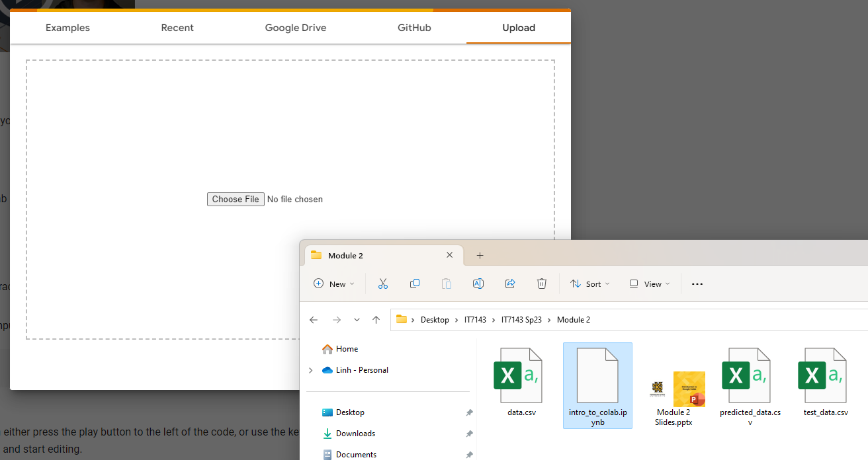
Google Colab
https://colab.research.google.com/
A cloud interactive Python environment tuned for Machine Learning
Each session is called a Runtime which is a session working with a Python notebook
When first open, Google Colab will ask to open a notebook which can be a prebuilt example, imported from Google Drive or GitHub, or uploaded
You will be asked to sign in if the current session is not linked to any Google accounts
Choose Upload and select the intro_to_colab.ipynb (available on D2L) file to start this module
Before working with this notebook, let us go through the basic of using Google Colab

Slide 3
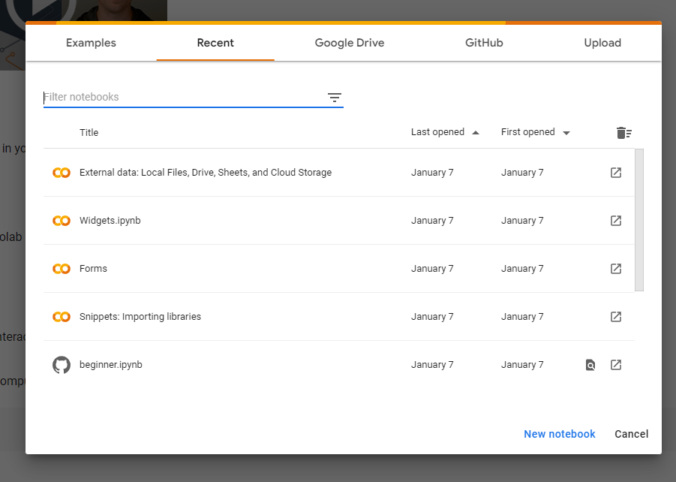
Create New Notebook
We can start a Runtime on a new notebook instead of loading one

Slide 4
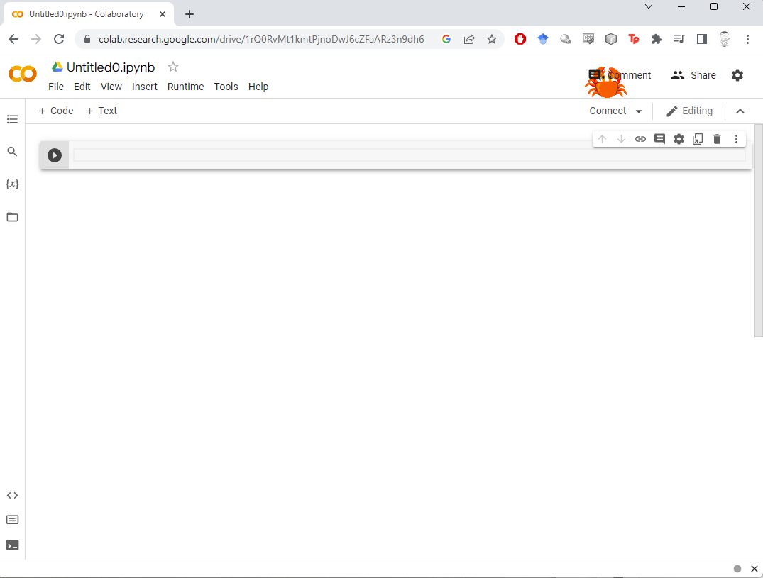
Basic Notebook Interface
The name of the notebook, can be changed by clicking on
A “cell” – a block of scripts. Can be executable codes or description texts
A notebook typically has many cells for codes and descriptions
Buttons to add a new code cell or a new text cell
Run button, executes all codes in a cell

Slide 5
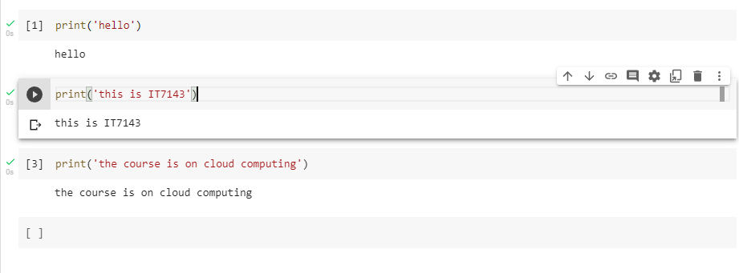
Code Cells
An executed cell. The [1] indicates the cell has already run, “1” means this cell is the first one ran in the notebook. The outputs of the codes in the cell, if there are any, appear directly below the cell.
Results from the cells, e.g., created variables, changes of states of anything, persist to the end of the session (unless changed by other codes)
Cells that carry runnable/executable codes
A cell that is being selected. The run button appears, and the codes can be edited. If the cell has run before, the output will keep showing
More options on a selected cell. Commonly used are the up/down arrows to move the cell up or down in the notebook, and the delete button
A cell that has not been executed, indicated by the empty [ ]. May or may not have codes. Can be edited by selecting it

Slide 6
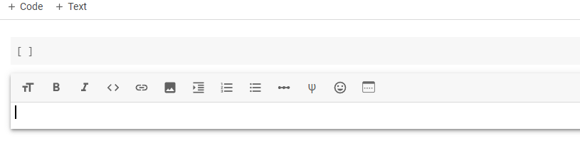
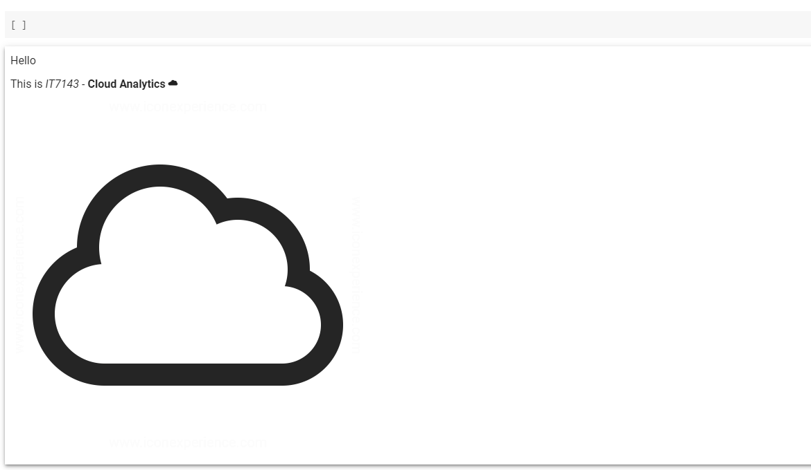
Text Cells
Cells that carry description text
Useful for comments on codes or describigng methods/results
Text cells support changes on font sizes, styles (bold, italic), inserting of links/images, numbered or bulleted lists, etc.

Slide 7
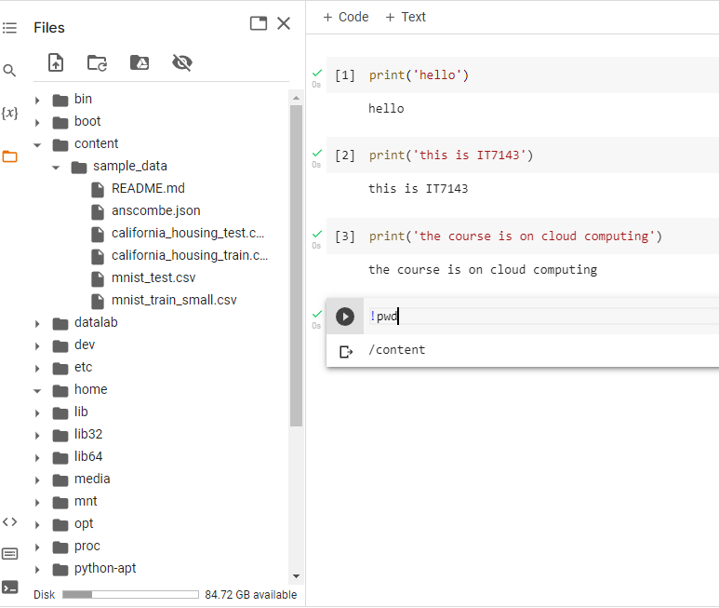
Working Location
The folder icon on the left sidebar displays/hides the Files structure
It is important to get familiar with the directory structure of the Runtime
By default, the working directory is /content/
The path of the current working directory can be obtained by running “!pwd”

Slide 8
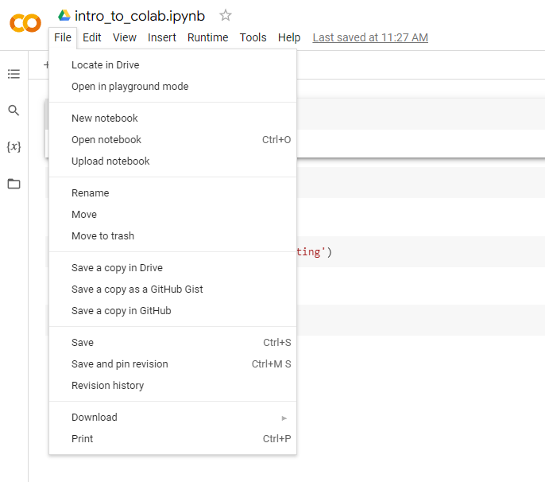
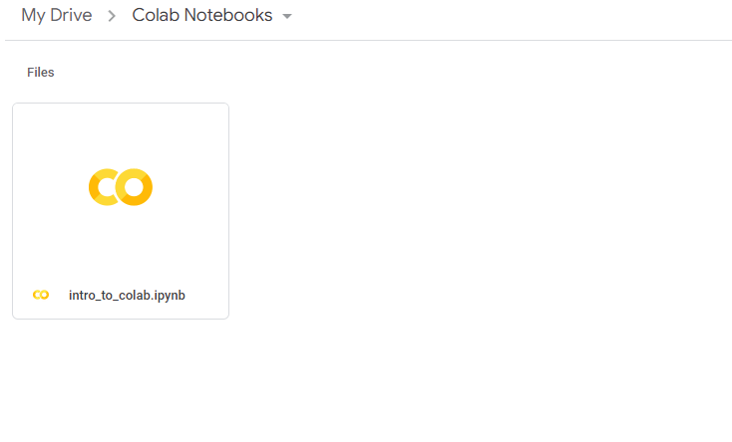
Save a Notebook
By default, saving a notebook will put it in the connected Google Drive
You can view the notebook from Google Drive as well

Slide 9
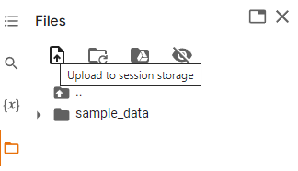
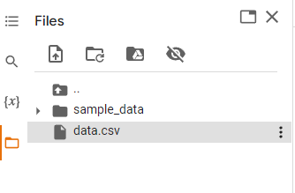
Upload Data
We can upload data files to the current session temporarily
Uploaded files are available only during the session and will be removed after the session
Verify if the file is uploaded by refreshing the Files tab

Slide 10
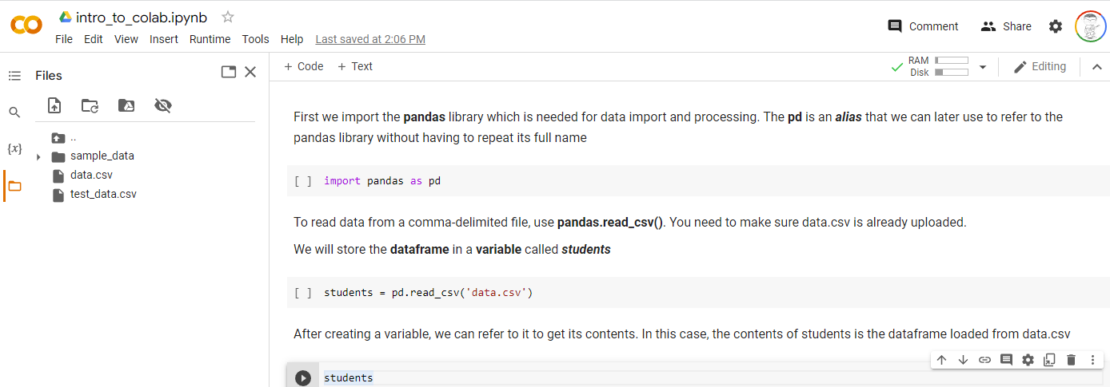

Continue in Notebooks
Please continue with the $intro_to_colab$ notebook
Remember to upload data.csv and test_data.csv to the session

Slide 11
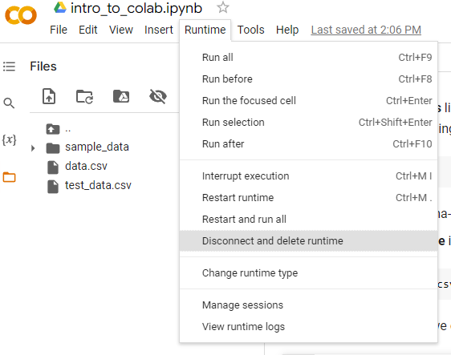
Stop a Runtime
Runtime → Disconnect and delete runtime
Remember, anything that are not saved will be deleted after stopping the runtime
So, always save your notebooks and output files, or connect and run your notebooks on Google drive

